Slide 1
Geothermal*

Slide 2

BIO-GAS
Today we will deal with:
What is Biogas?
How biogas is generated?
Factors affecting biogas generation
Biogas Technologies
Application/Uses of Biogas

Slide 3
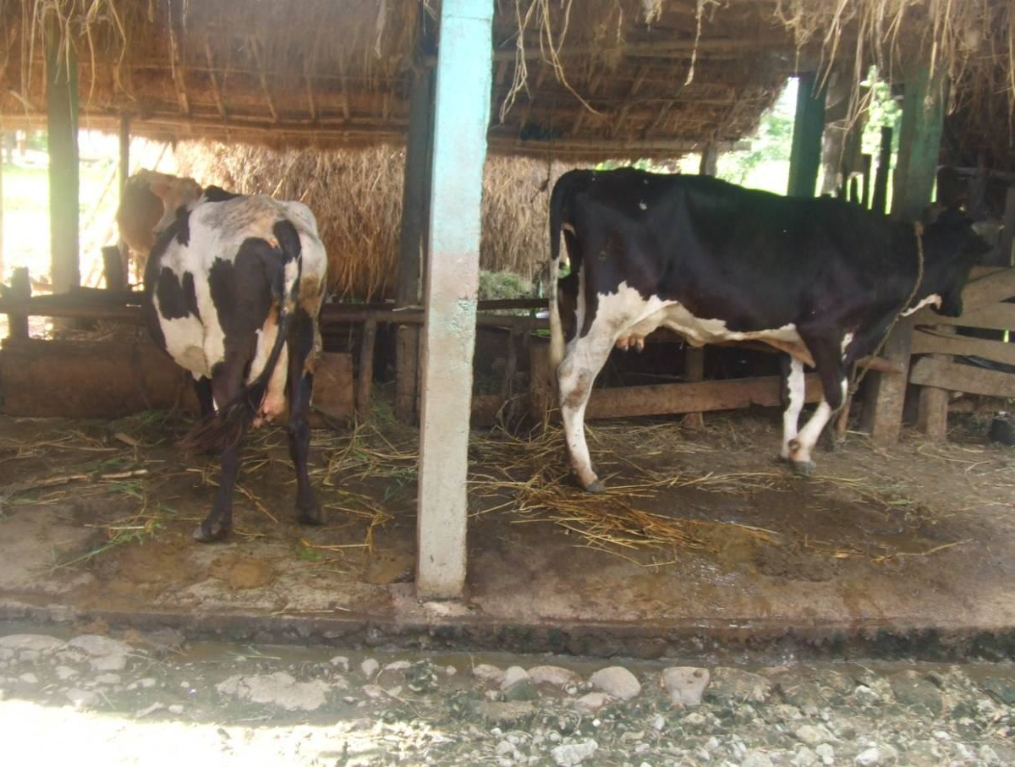
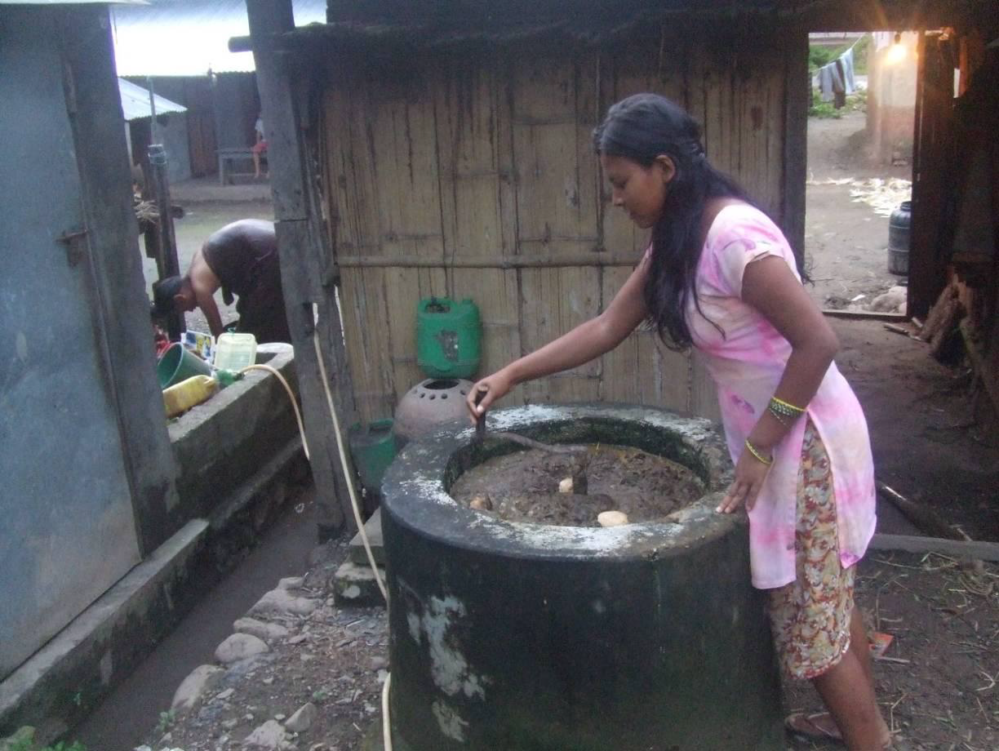
You may familiar/experienced..

Slide 4

INTRODUCTION
Biogas is clean environment friendly fuel that can be obtained by anaerobic digestion of animal residues and domestic and farm wastes, abundantly available in the countryside.
Biogas is an important renewable energy resource for rural areas in Nepal
Biogas generally comprise of 55-65 % methane, 35-45 % carbon dioxide, 0.5-1.0 % hydrogen sulfide and traces of water vapor.
Average calorific value of biogas is 20 MJ/m³ (4713 kcal/m³).

Slide 5

ANAEROBIC DIGESTION
What is done is ANAEROBIC FERMENTATION.
Fermentation is a process of change in organic matter
brought about by living organisms.
Anaerobic refers to use of anaerobic bacteria for
the purpose of fermentation.

Slide 6
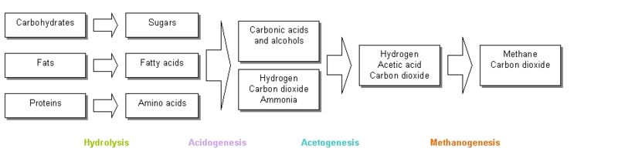
BIOGAS PRODUCTION PROCESS
Biogas production process (Anaerobic digestion) is a multiple-stage process in which some main stages are:
Chemical reactions involved in biogas production:
C₆H₁₂O₆ → 3CO₂ + 3CH₄
CO₂ + 4H₂ > CH₄ + 2H₂O
CH₃COOH > CH₄ + CO₂

Slide 7
Factor Affecting the Biogas generation
The nature and concentration of the substrate,
Feed rate,
pH value,
Bacterial population,
Temperature, and
Chemical inducers.

Slide 8
UTILIZATION OF BIOGAS
Cooking: Biogas can be used in a specially designed burner for cooking purpose. A biogas plant of 2 cubic metres capacity is sufficient for providing cooking fuel needs of a family of about five persons.
Lighting: Biogas is used in silk mantle lamps for lighting purpose. The requirement of gas for powering a 100 candle lamp (60 W) is 0.13 cubic metre per hour.
Power Generation: Biogas can be used to operate a dual fuel engine to replace up to 80 % of diesel-oil. Diesel engines have been modified to run 100 per cent on biogas. Petrol and CNG engines can also be modified easily to use biogas.
Transport Fuel: After removal of CO₂, H₂S and water vapor, biogas can be converted to natural gas quality for use in vehicles.

Slide 9
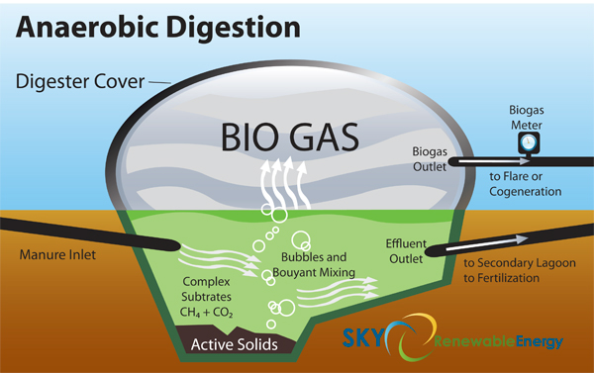

Slide 10
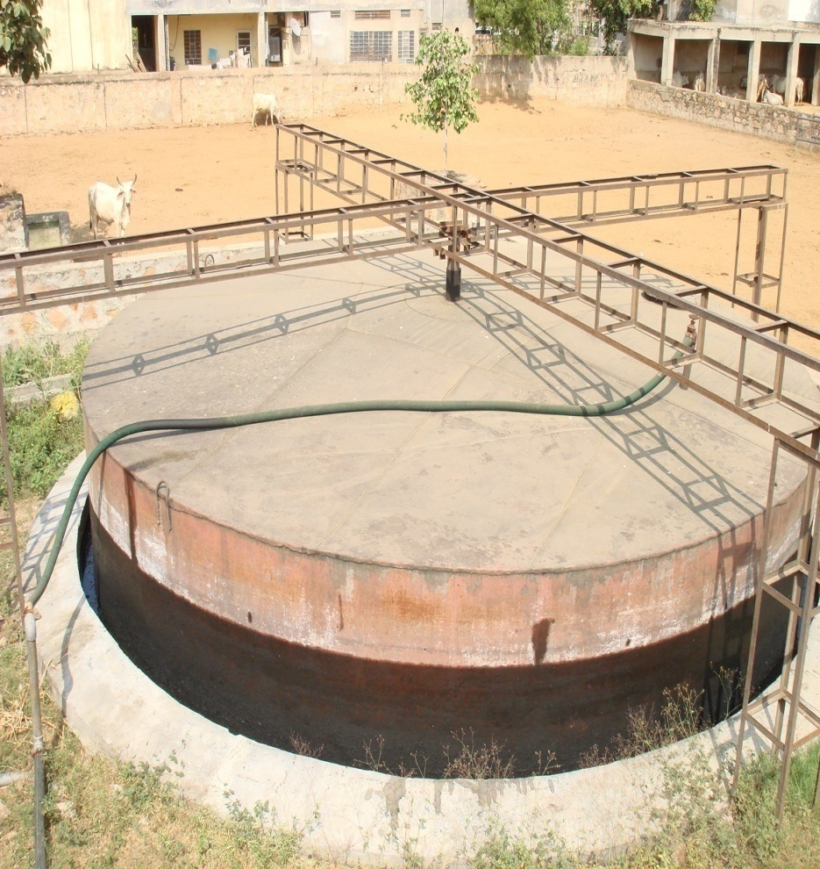
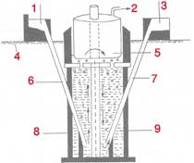
Types of Biogas plants:-
1- Floating drum type with different measurements.

Slide 11
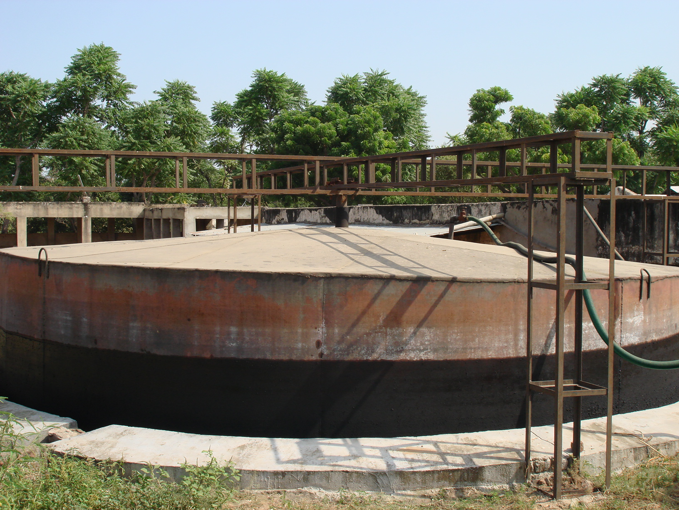

Bio Gas Plant
LOW
HALF
FULL

Slide 12
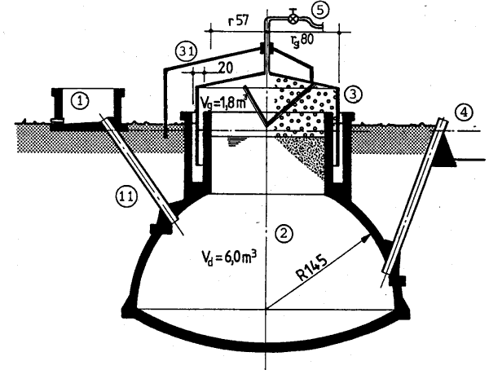
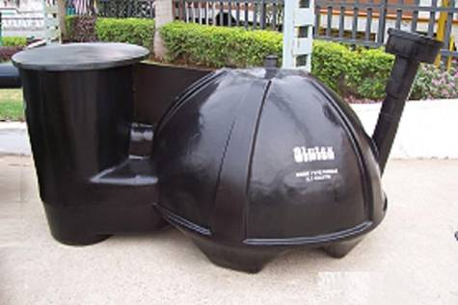
2- Modified drum type (Deenbandu)

Slide 13
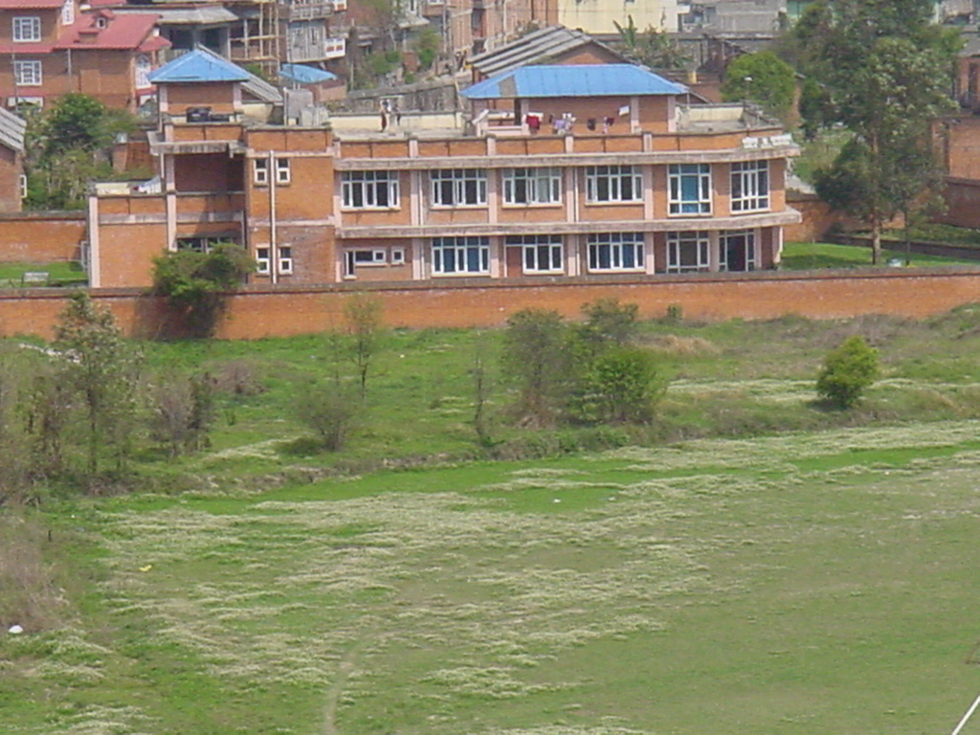
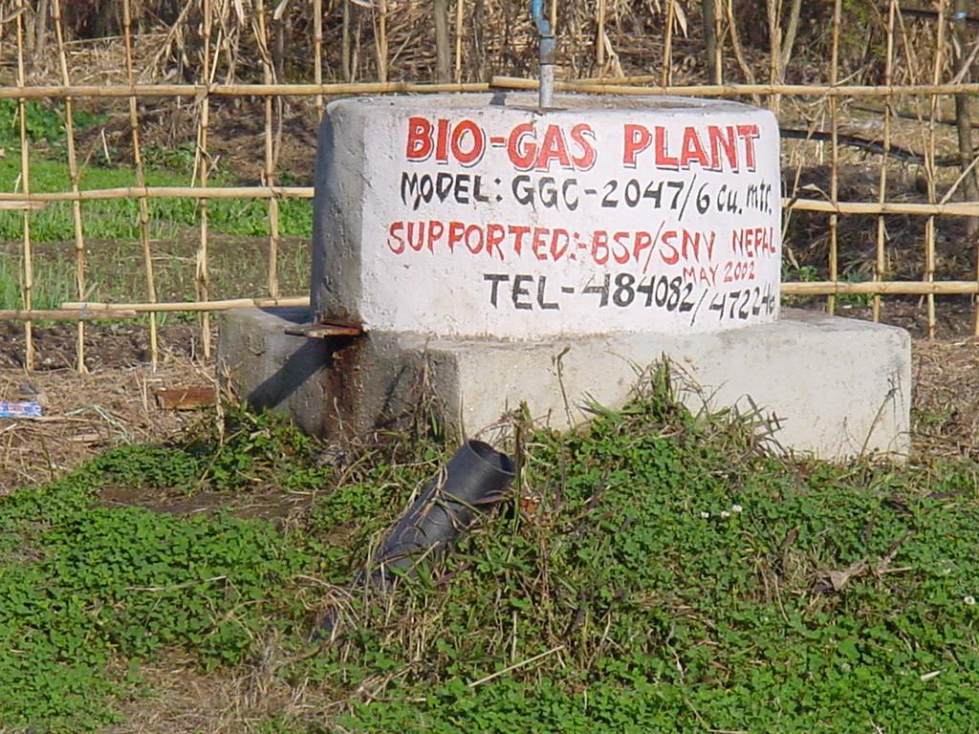
Biogas Plant

Slide 14
Uses of Biogas
Biogas can be directly used for cooking and lighting by supplying the gas though pipes to households from the plant.
Biogas has been effectively used as a fuel in industrial high compression spark ignition engines.
To generate electricity an induction generator can be used and is the simplest to interface to the electrical grid.
Biogas can also be used as fuel in a hot water heater if hydrogen sulfide is removed from the gas supply.

Slide 17
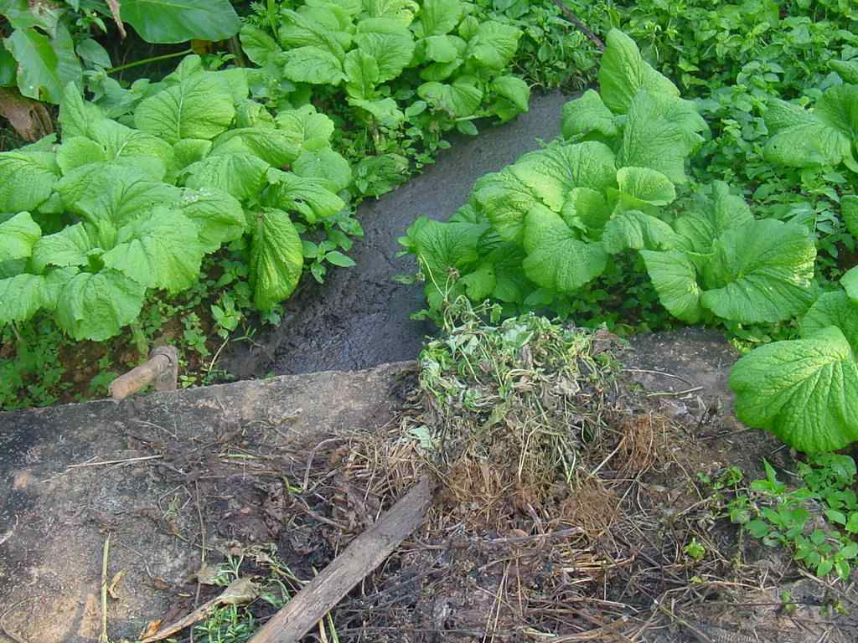

Slide 18
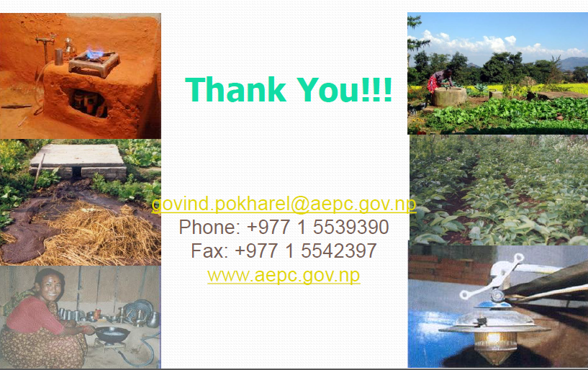

Slide 19
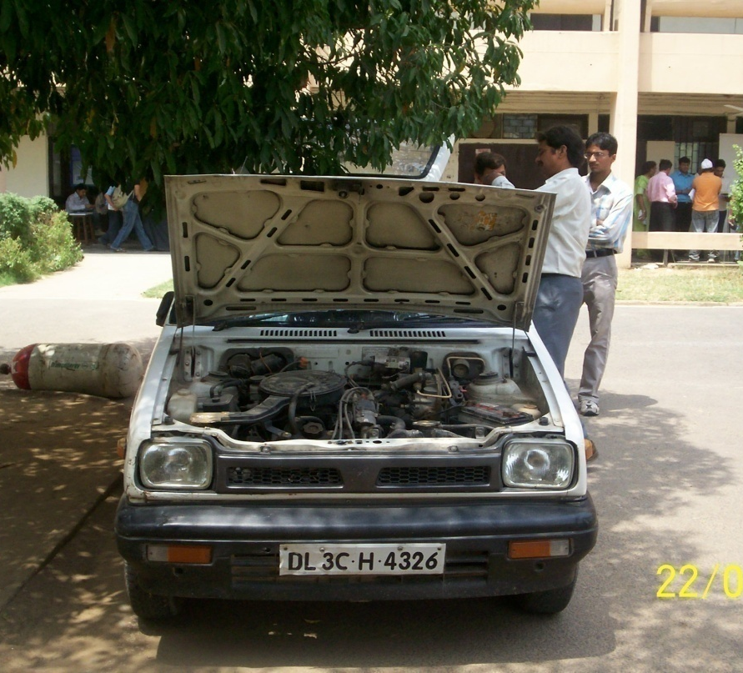
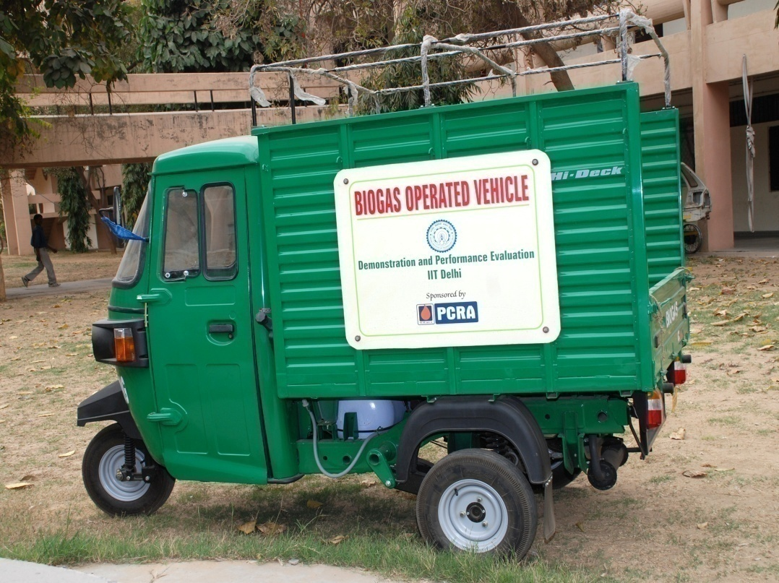
AUTOMOTIVE CAR AND THREE WHEELER RUNNING ON ENRICHED BIOGAS

Slide 20
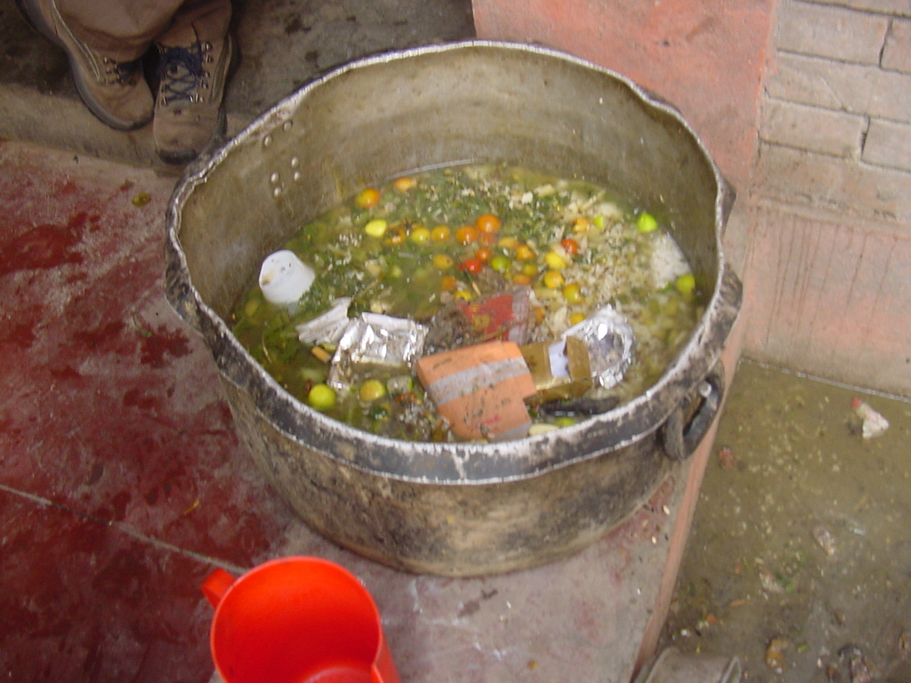
Kitchen Waste/ Toilet

Slide 21
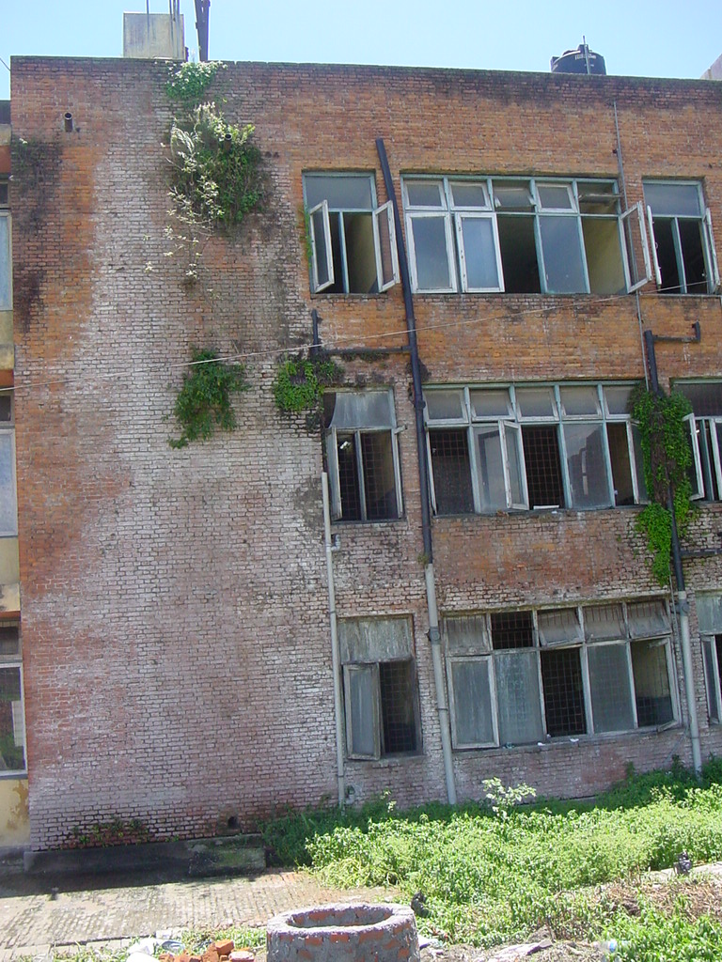
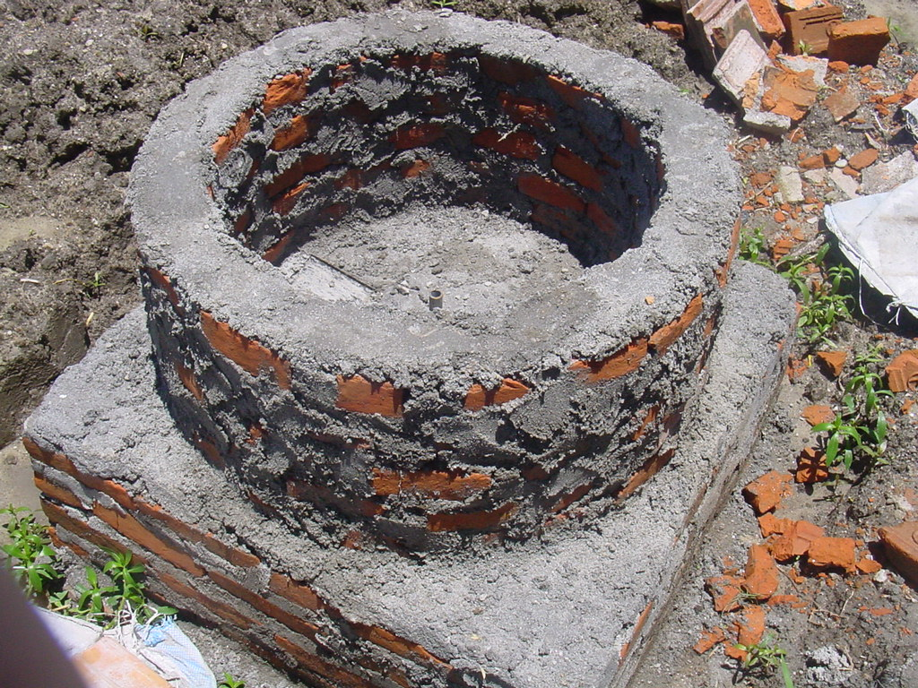

Slide 22
Continue…….

Slide 23
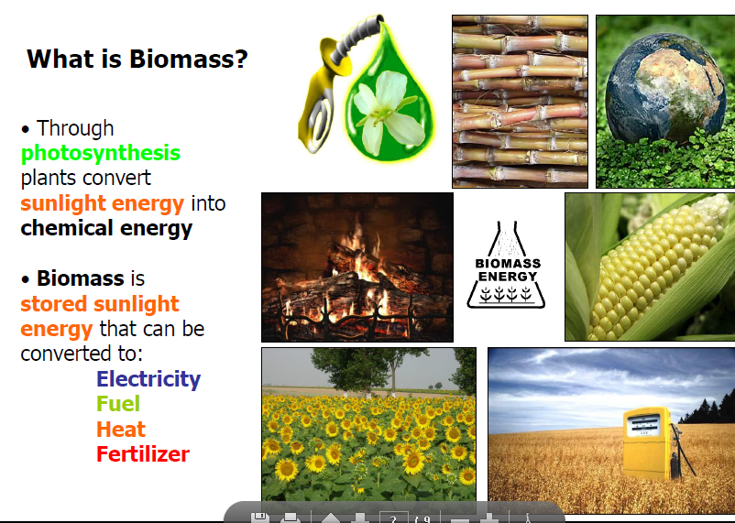

Slide 24
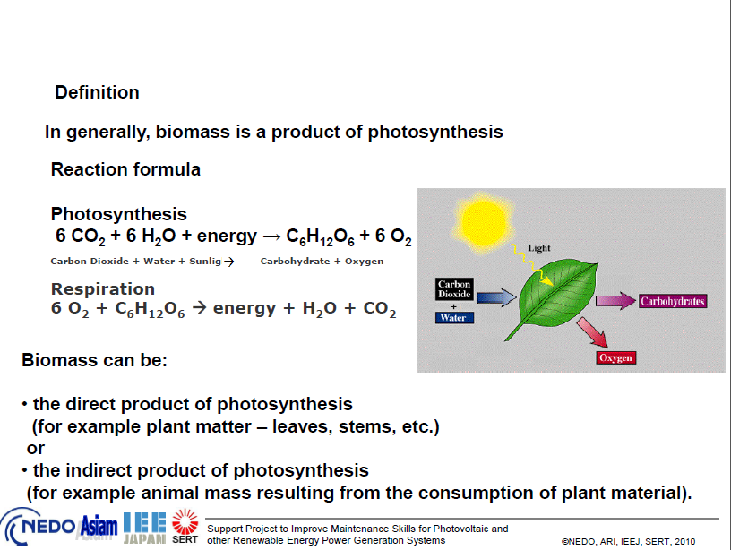

Slide 25
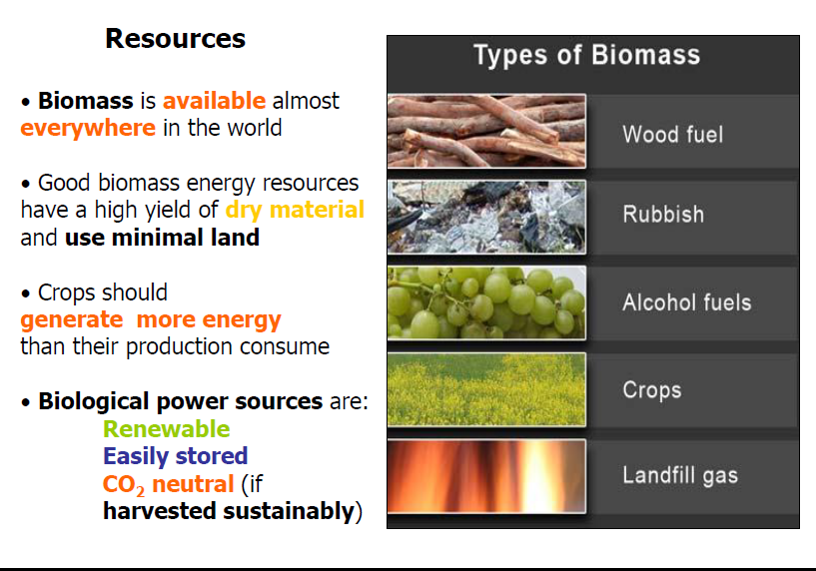

Slide 26
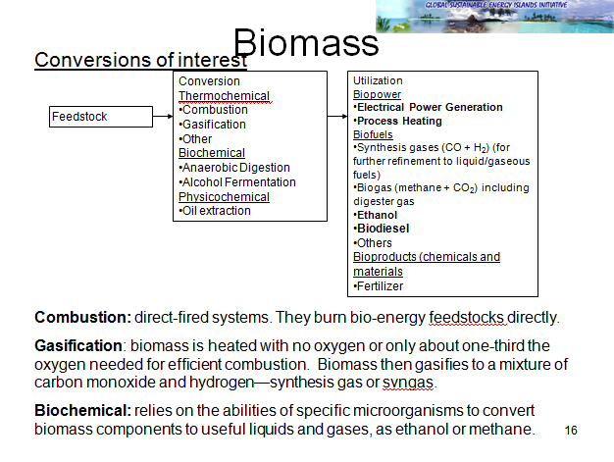

Slide 27
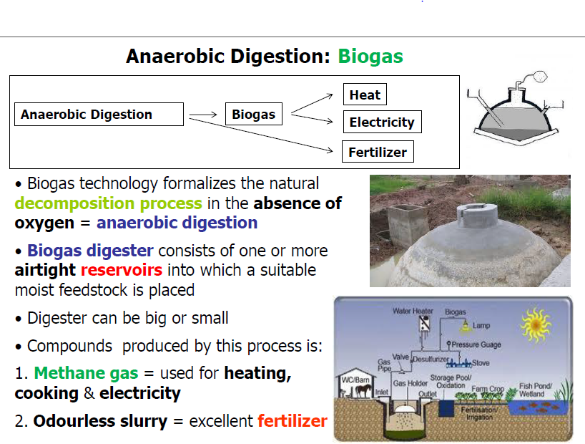

Slide 28
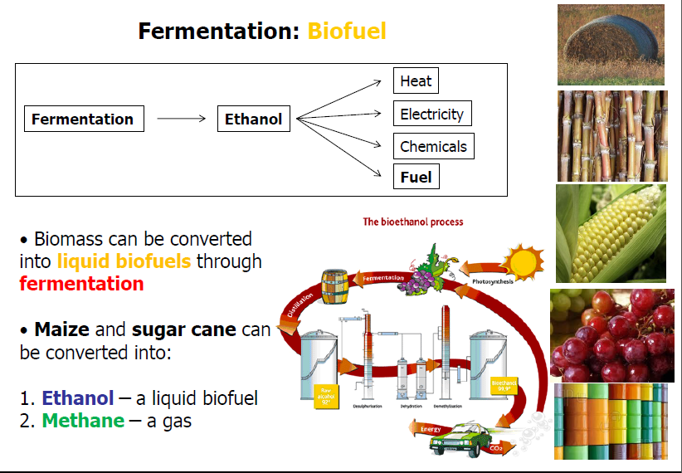

Slide 29
Ethanol Production
Natural sugarcane
Best fruit
Crush
Residue
Process heat, byproducts
Starches: grains
Hydrlysis
Sugar
Yeast fermentation
to 10% ethanol
Distillation to
95% ethanol
General
Combustion fuel
Cellulose wood
Hydrolysis
Petroleum additive
Or substitutes
Purification to
Anhydrous alcohal

Slide 30
Thank You !!!
Refer Reading Materials 1 & 2 for detail
( Examination Purpose)

